Slide 1

Binary classification with Logistic Regression Algorithm using Hadoop
Presenter
Sajib Sen
1

Slide 2
Outline:
Brief Introduction of Logistic Regression
An ideal solution
Design
Analysis

Slide 3
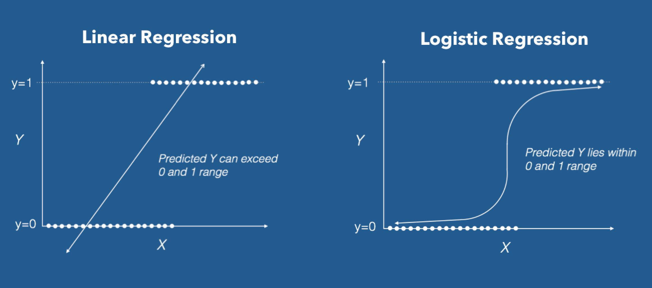
Brief Introduction of Logistic Regression

Slide 4
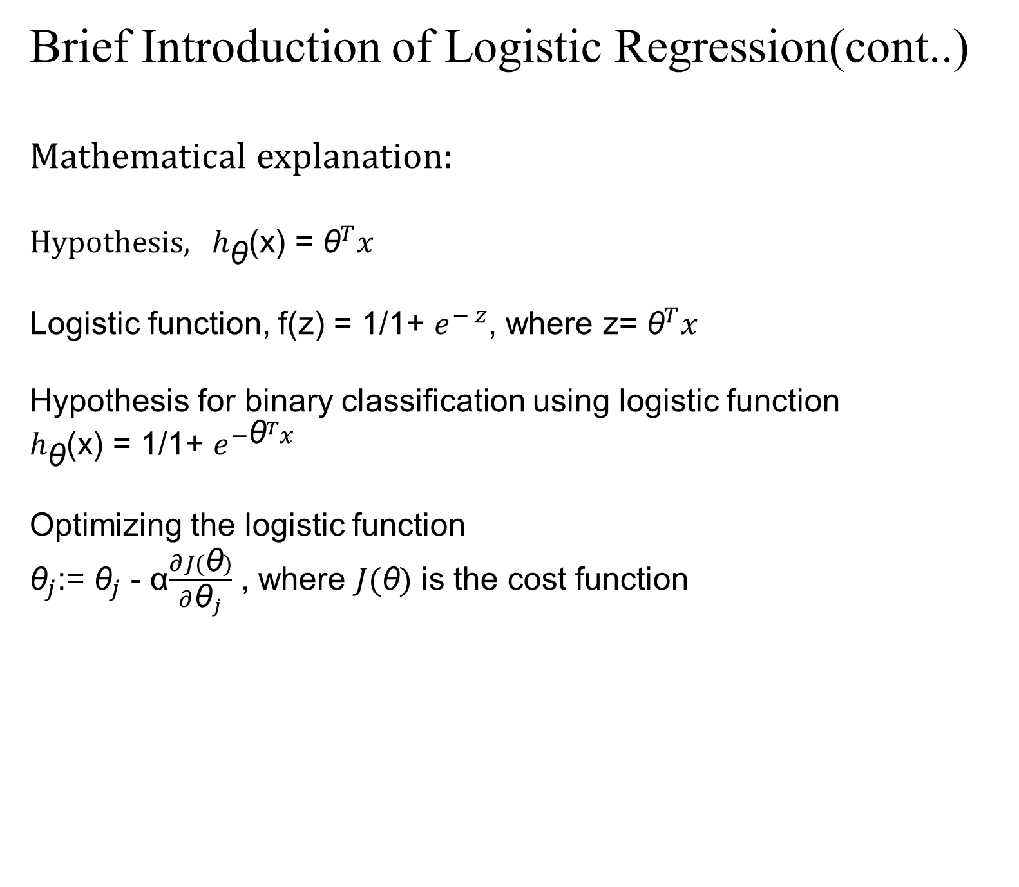
Brief Introduction of Logistic Regression(cont..)
Mathematical explanation:
Hypothesis, ${ h}_{\text{θ}}$(x) = ${\text{θ}}^{T}x$
Logistic function, f(z) = 1/1+ $e^{− z}$, where z= ${\text{θ}}^{T}x$
Hypothesis for binary classification using logistic function $h_{\text{θ}}$(x) = 1/1+ $e^{−{\text{θ}}^{T}x}$
Optimizing the logistic function ${\text{θ}}_{j}$:= ${\text{θ}}_{j}$ - α$\frac{∂J(\text{θ})}{∂{\text{θ}}_{j}}$ , where $J(\text{θ})$ is the cost function

Slide 5
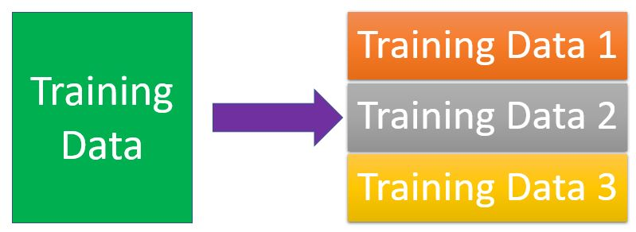
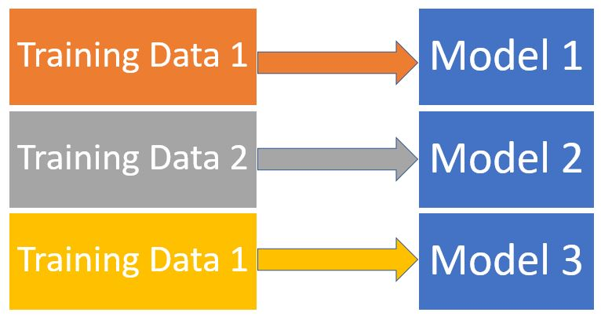
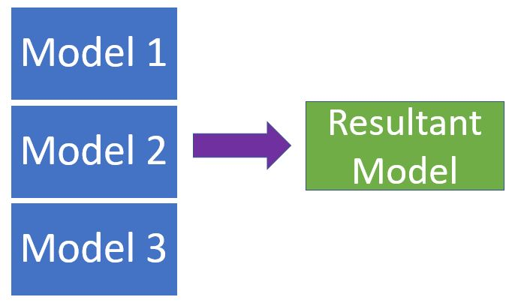
An Ideal Solution

Slide 6
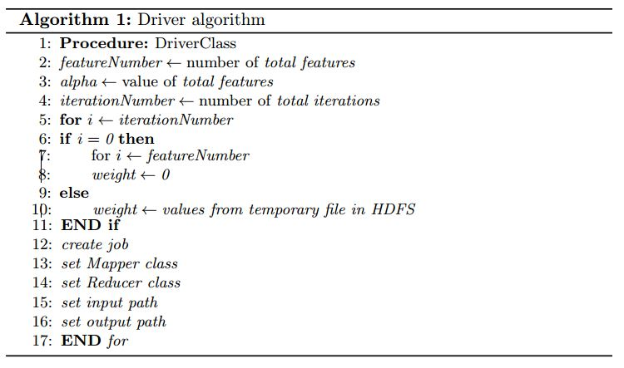
Design

Slide 7
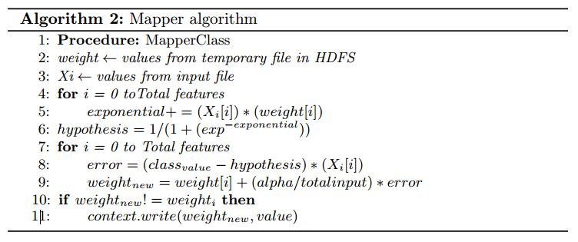
Design(cont..)

Slide 8
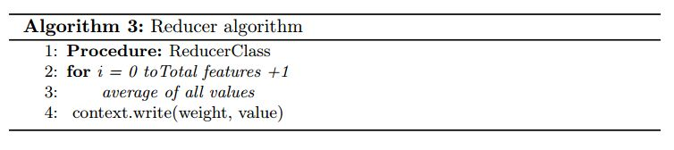
Design(cont..)

Slide 9
Analysis
The dataset is for those women who are disgnosed for diabetes. Each row is an input and each column is the attribute for the input except the last column is the output. The output is in binary, where 0 means tested negative for diabetes and 1 for positive.
1 85 66 29 0 26.6 0.351 31 0 8 183 64 0 0 23.3 0.672 32 1

Slide 10
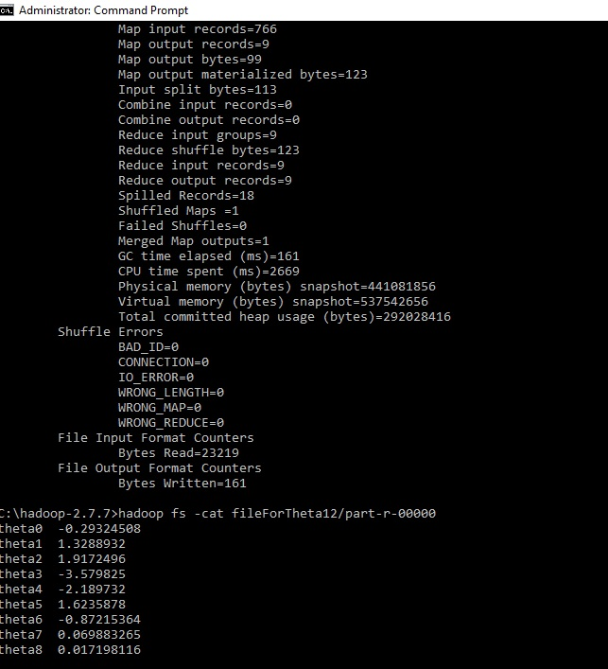
Analysis(cont..)

Slide 11
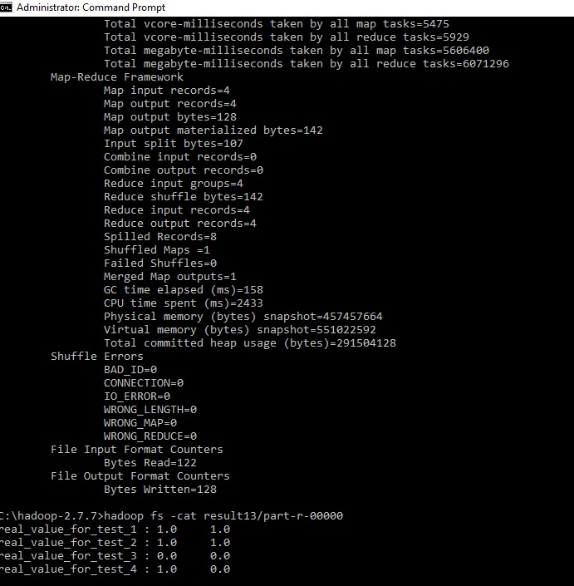
Analysis(cont..)

Slide 12
Thank you
4/30/18
12

